Slide 1
RAGNAROK
Board relation

Slide 2
Main tasks
General info
1
Development
2
Heuristic
3
Overview of rules game, comunication with server, dataset.
Algorithm and structure
Result and optimization

Slide 3
“I think the brain is essentially a computer and consciousness is like a computer program. It will cease to run when the computer is turned off. Theoretically, it could be re-created on a neural network, but that would be very difficult, as it would require all one's memories.”
—Stephen Hawking

Slide 4
1. General Info

Slide 5
The Game
Game & Rules
Principal Issues
Dataset
1.
2.
1.
2.
1.
2.

Slide 6
2. Development

Slide 7
Algorithm
We found different approaches for development of this game, but we've tested just search algorithms:
Minimax
Alpha-beta pruning
Negamax

Slide 8
Structure code
Simple view about our structure of code:
Class Game
Class AlphaBeta
Class TT
Class Game: contains rules of game
Class AlphaBeta: contains algorithm search
Class TT: contains transposition table

Slide 9
3. Heuristic

Slide 10
Heuristic
After the first step of implementation, we try to improve our algorithm with this simple heuristics:
First
First
First
s
s
s

Slide 11
Conclusion
Final Comment:

Slide 12
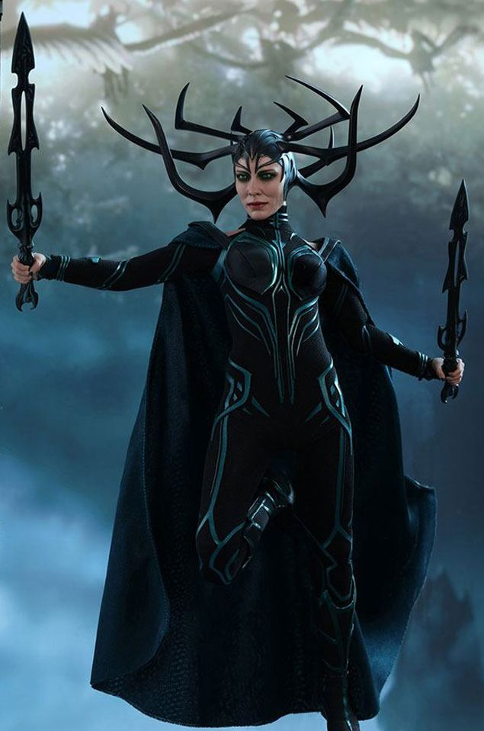
Thank You

